Slide 1
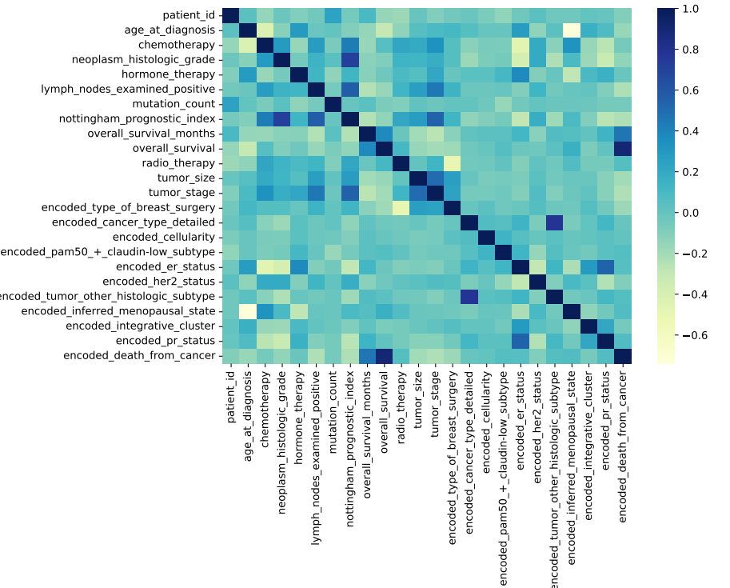
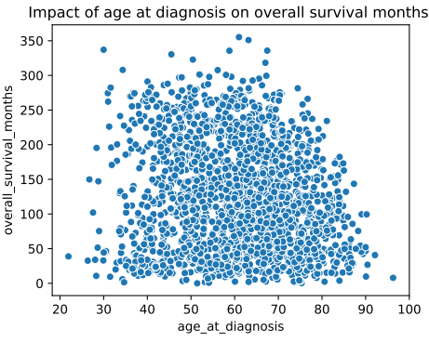
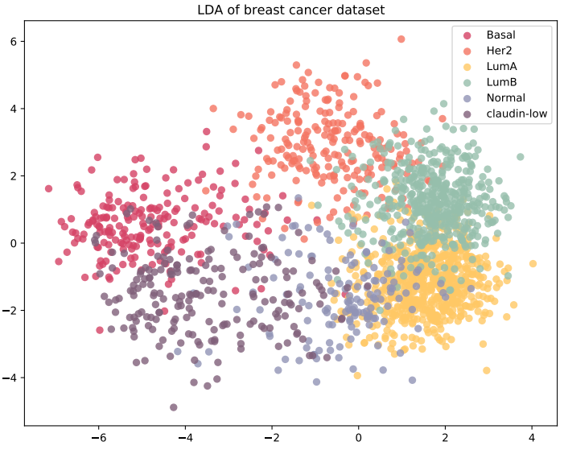
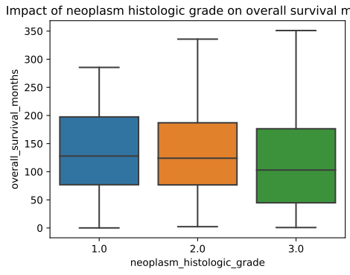
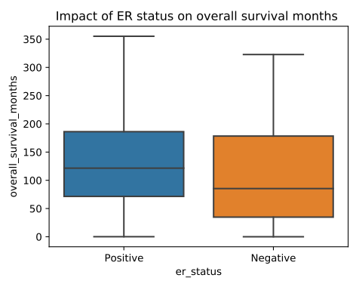
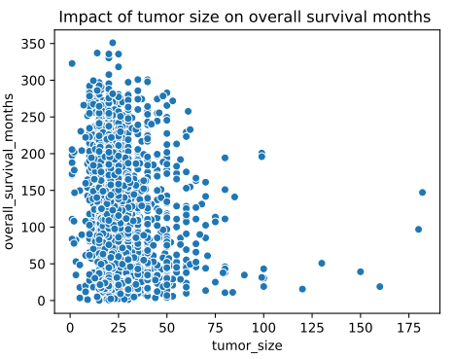
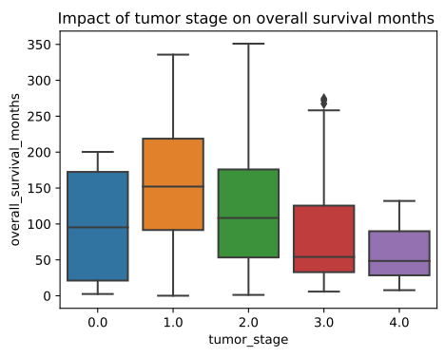
Summary
Feature selection X-Correlation Matrix
Self-evaluation
Age
LDA class
N-H grade
ER status
Tumor Size
Tumor Stage

Slide 2
Learn about our prediction based on your diagnosis
Get started , it’s free
Metric 1
Drop down Box 1
Based on the information provided, here is our prediction:
Metric 2
Drop down Box 2
Survival
…………………………………….
Longivity

